Slide 1
MISSION UPDATES
December 2025

Slide 2
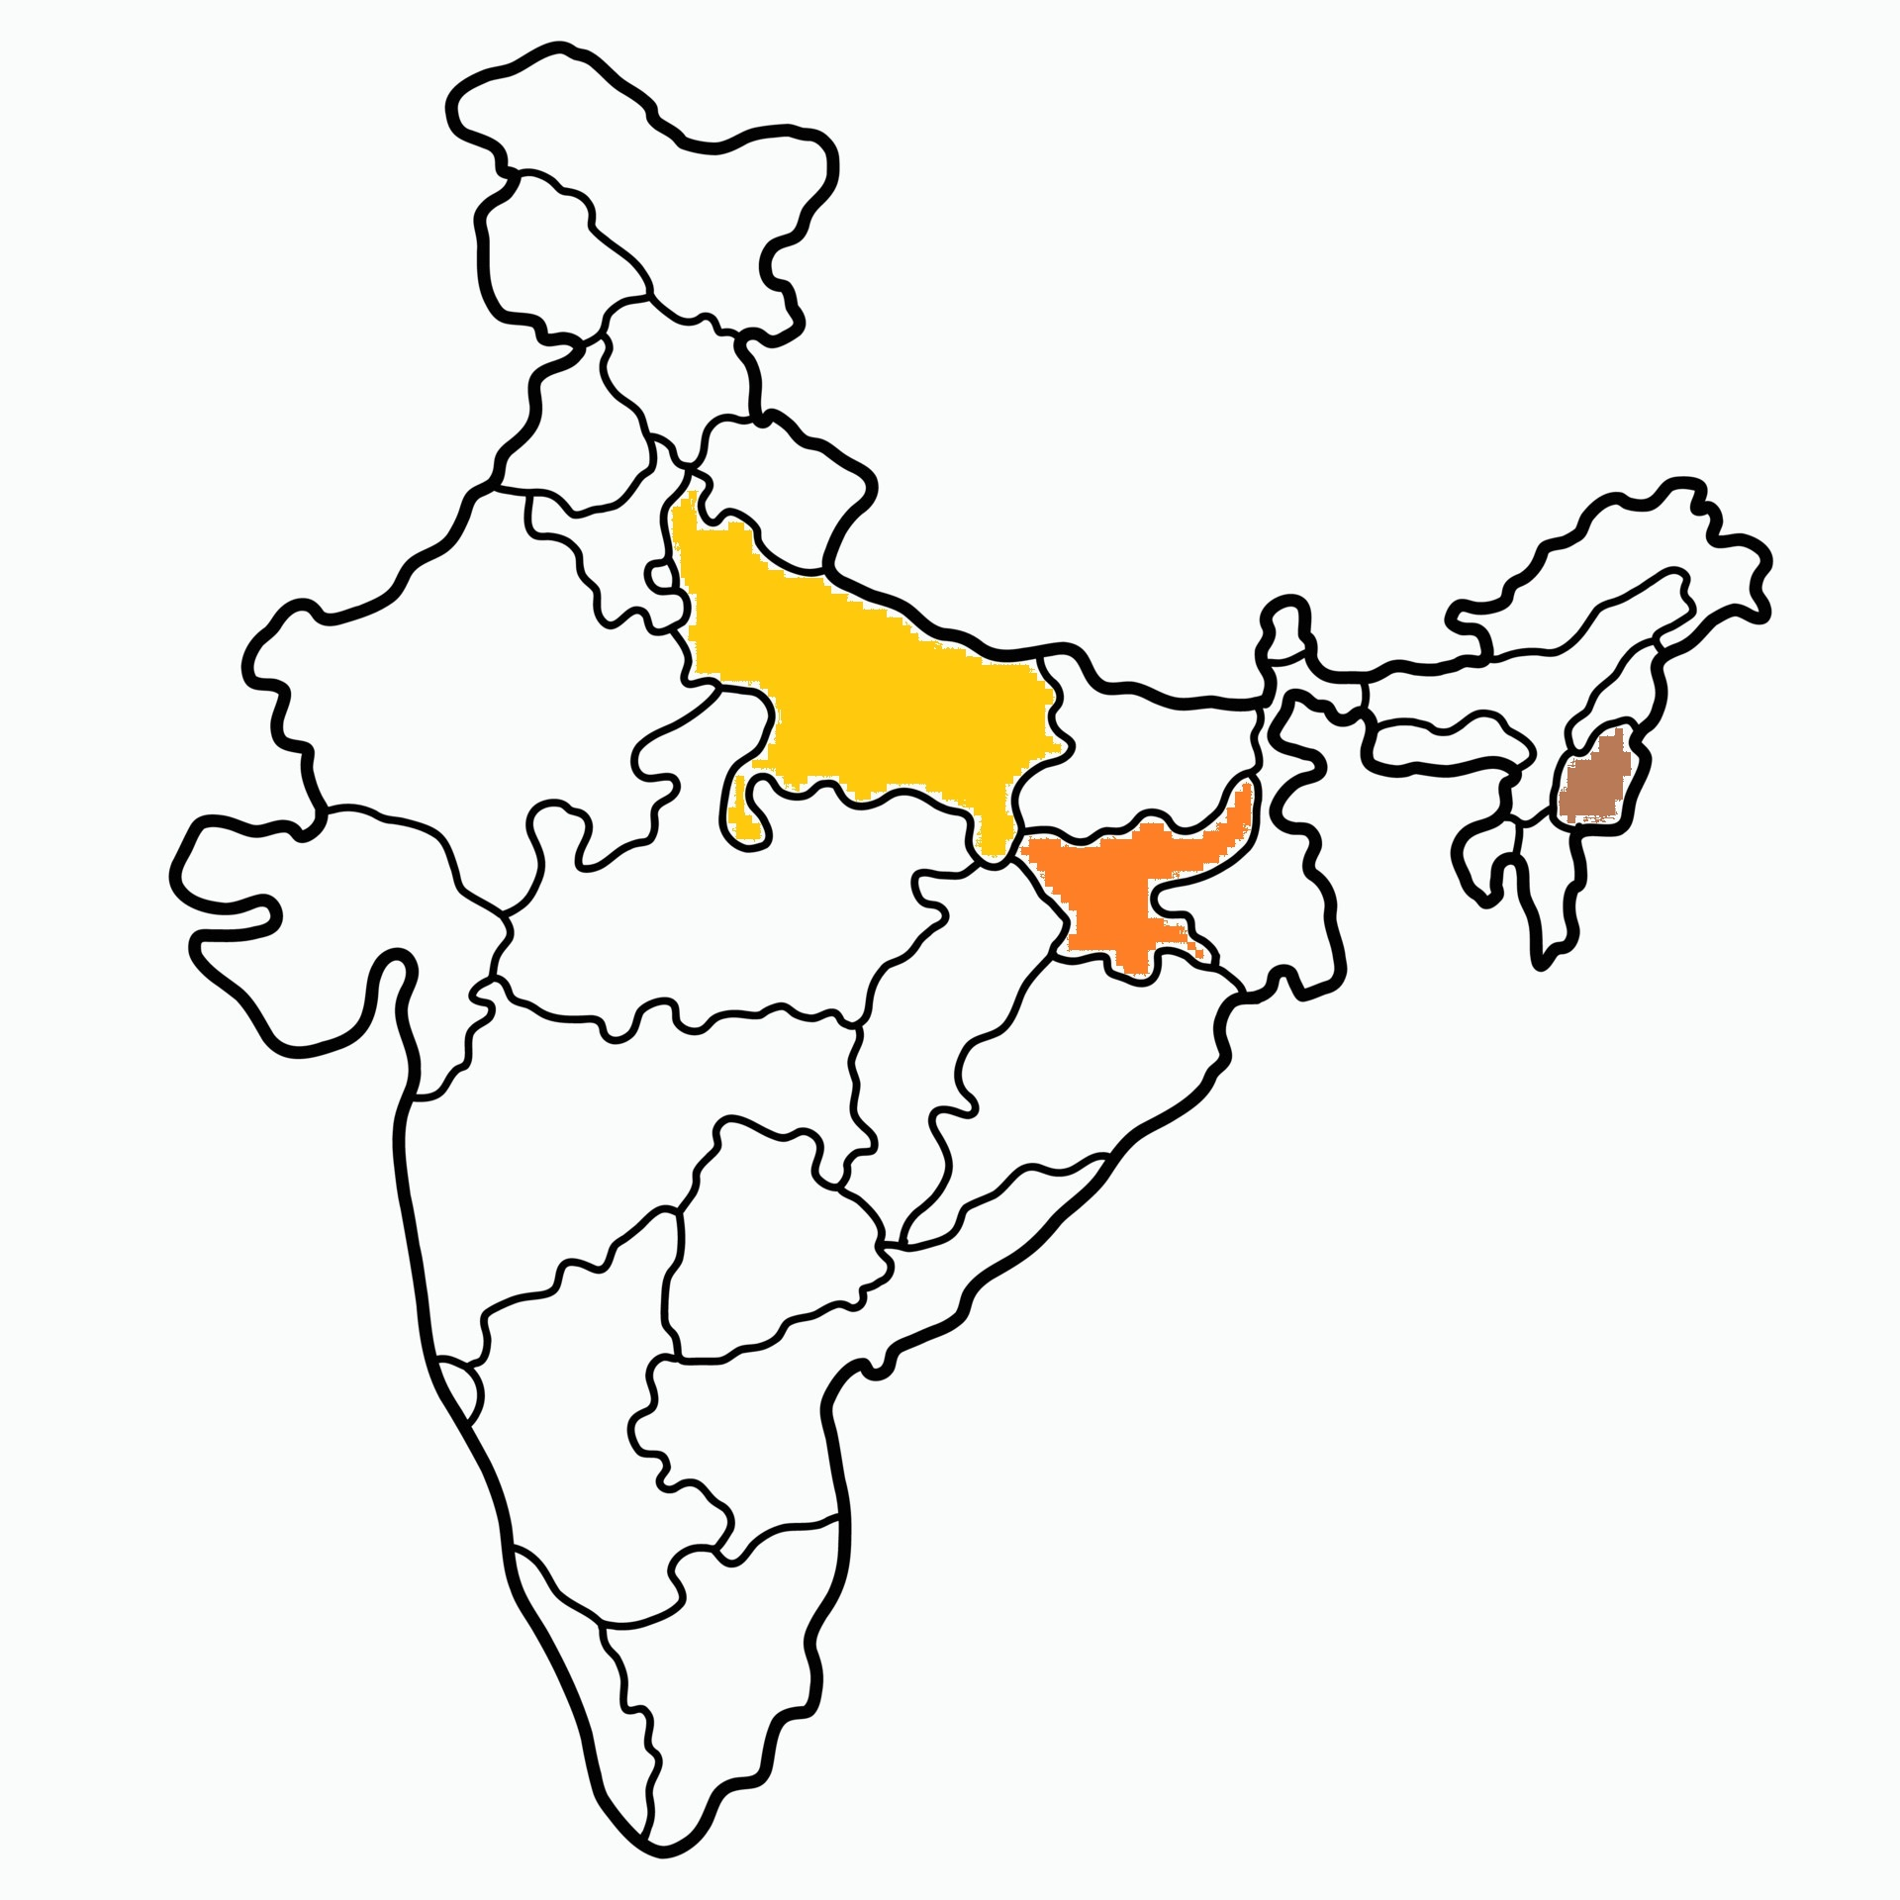

Slide 3
Mission Stations
10 mission stations supported in Jharkhand.
5 mission stations supported in U.P.
1 ICPF workstation supported in North-east(Dimapur) India.

Slide 4
NORTH INDIA MISSION
UP
Pr. Sunny George
5 Stations
Balia and Varanasi Districts
Jharkhand
Pr. Sam
10 Stations
Khunti District
ICPF
Sr. Priscilla Ngullie
1 Station - Dimapur

Slide 5
Jharkhand

Slide 6
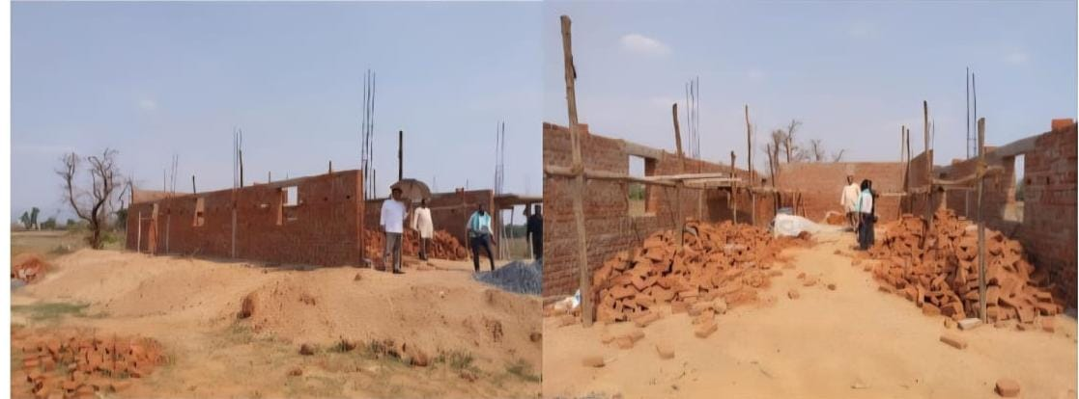
Church Building under construction
This building is in Bargarh, which is in Gharwa District.

Slide 7
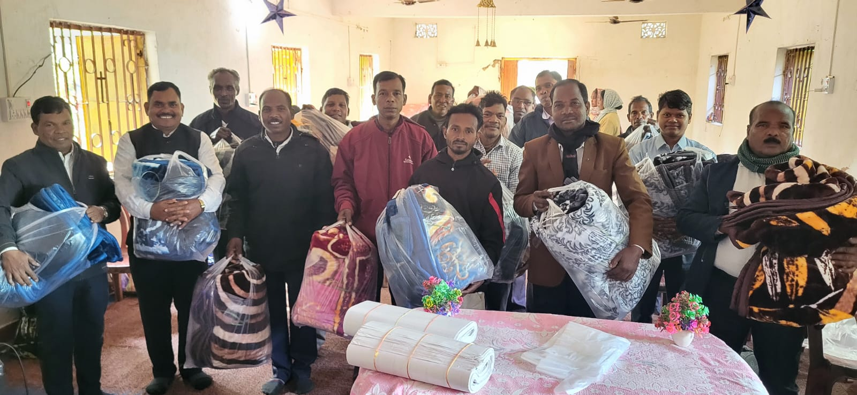
Blanket Distribution

Slide 8
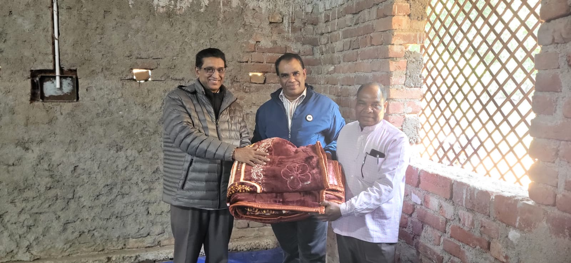

Slide 9
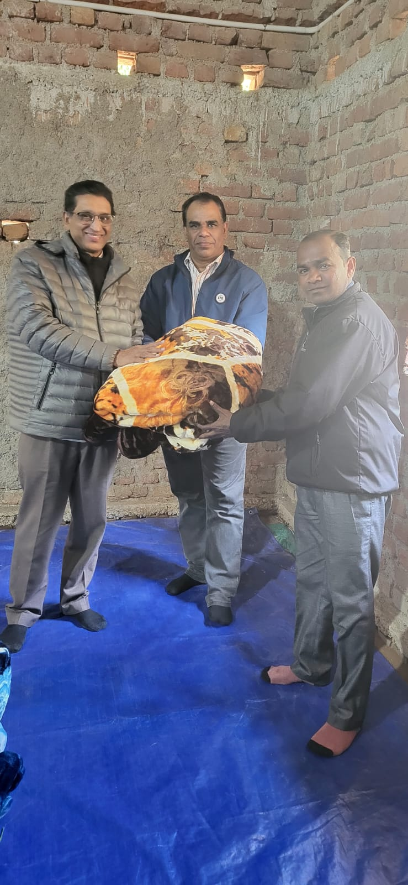

Slide 10
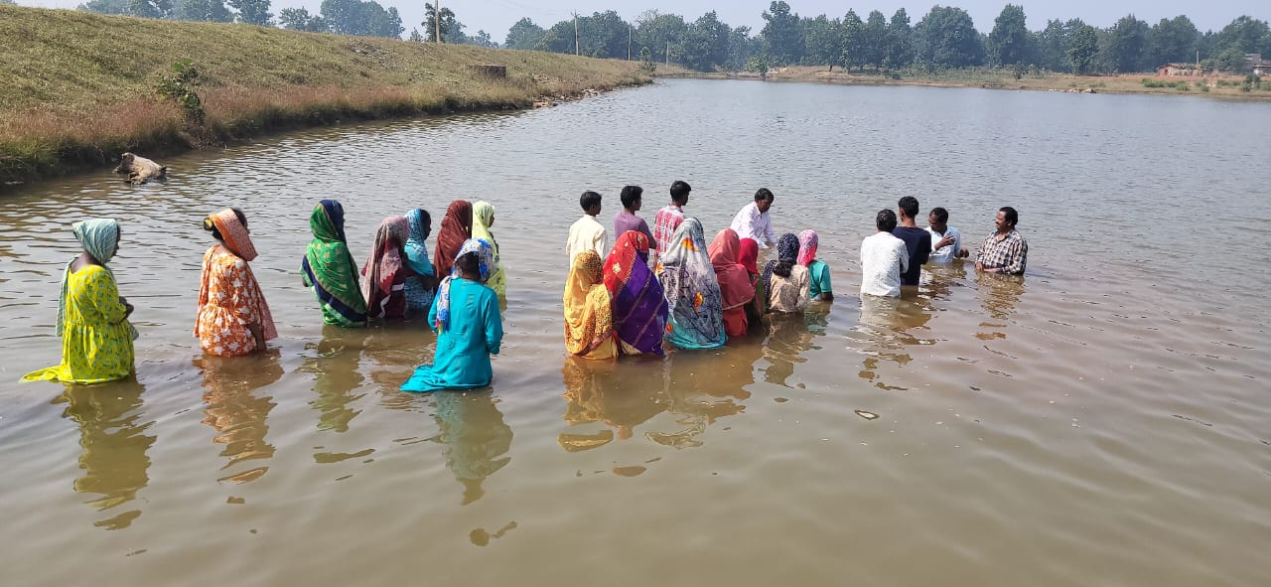
Baptism - 55 people received Baptism this month.

Slide 11
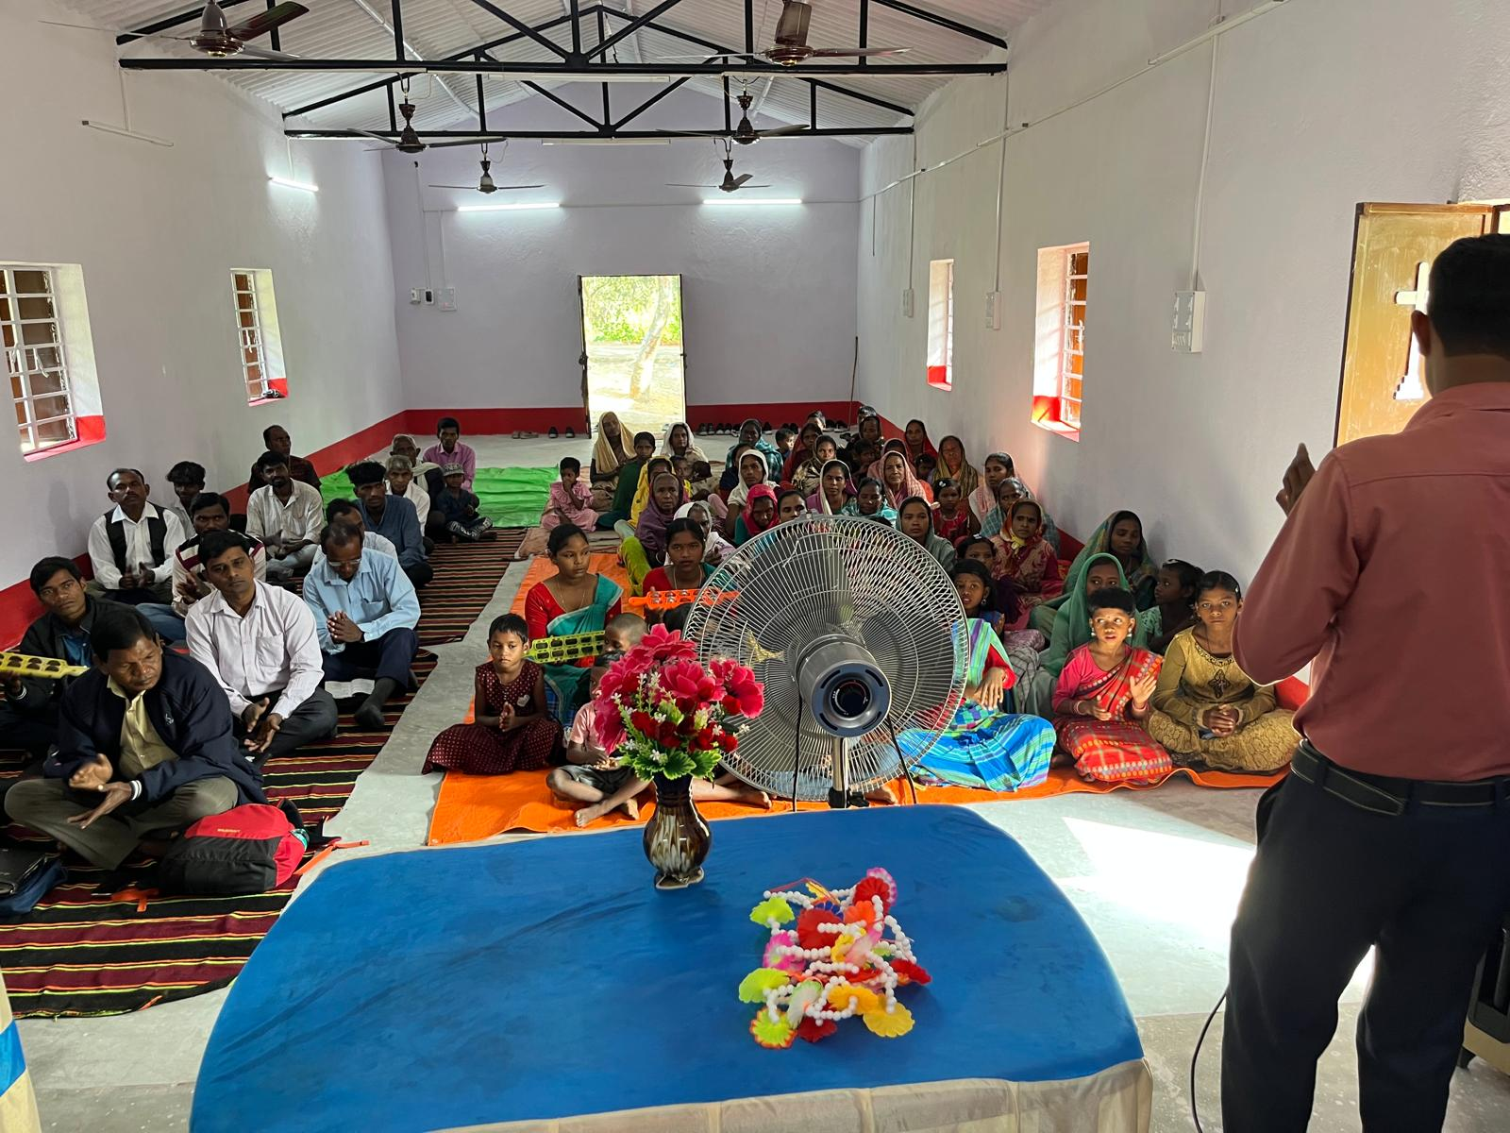
Village Church

Slide 12
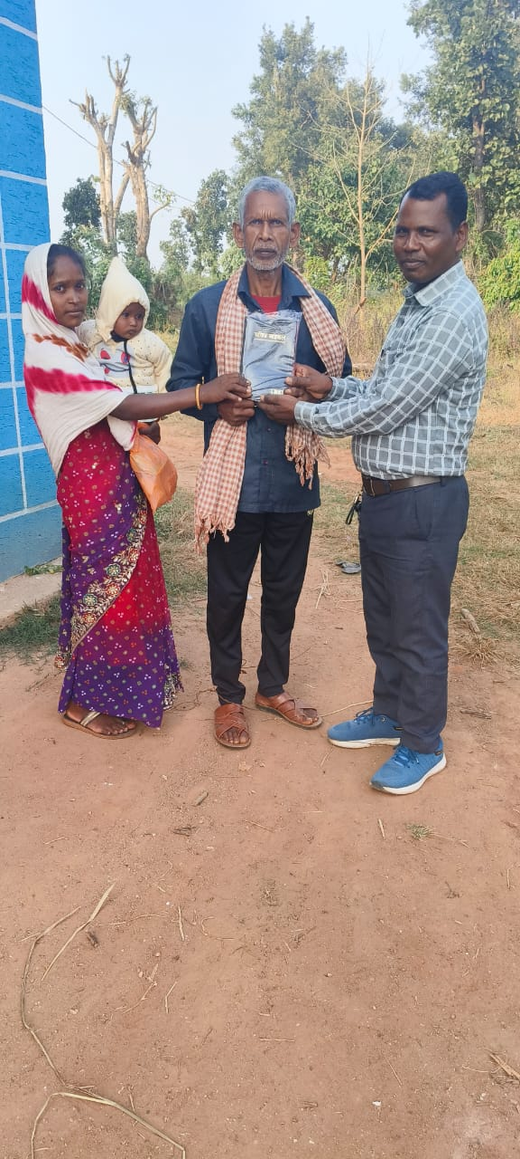
New believers

Slide 13
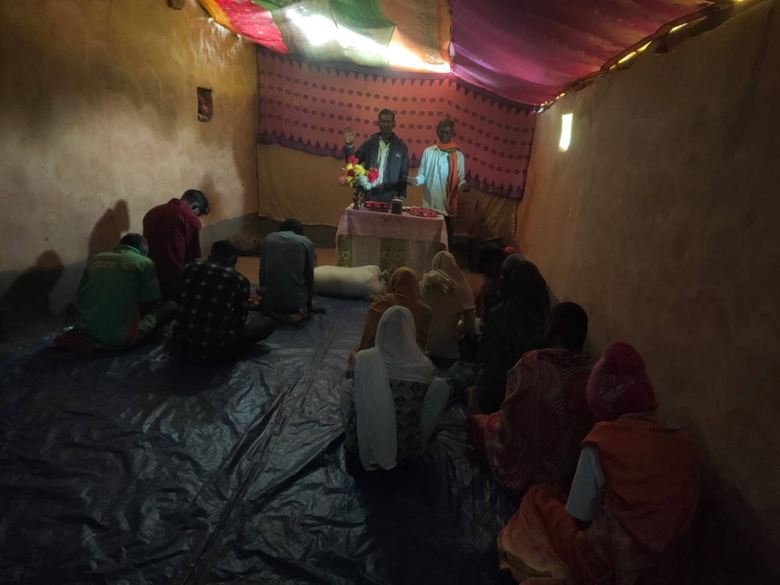
Cottage Meeting

Slide 14
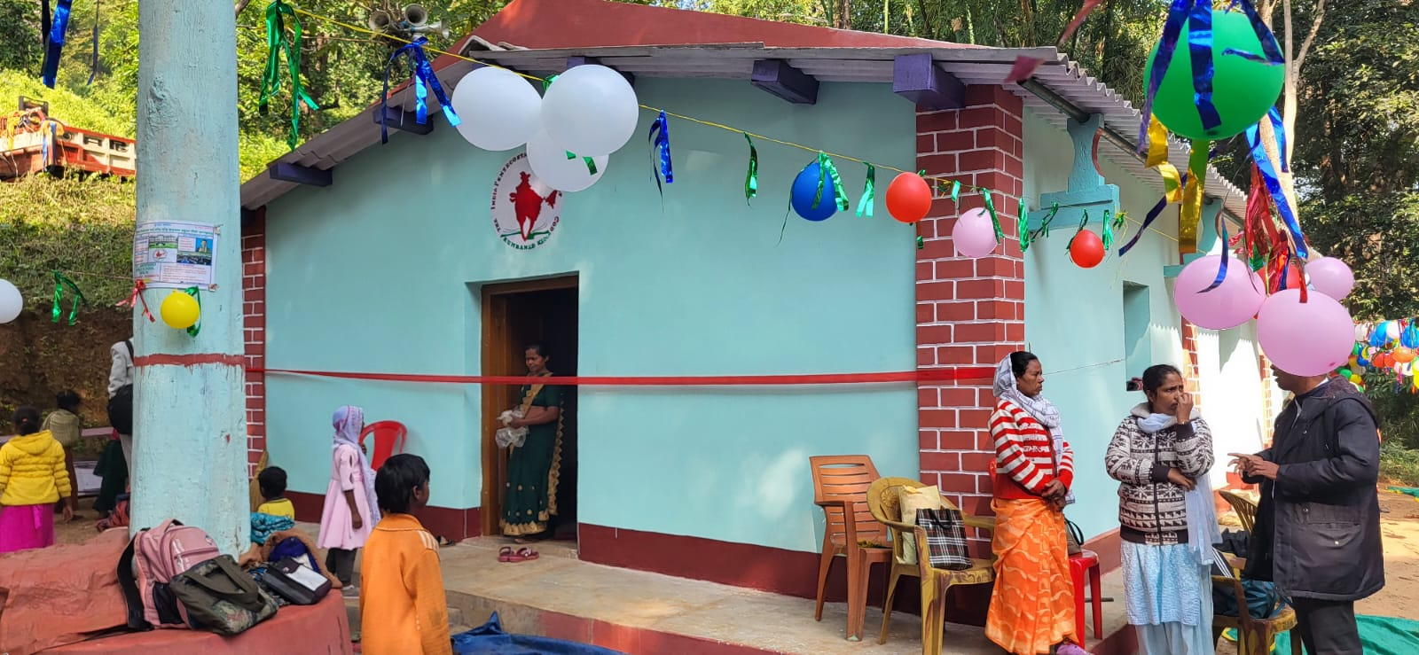
New Church

Slide 15
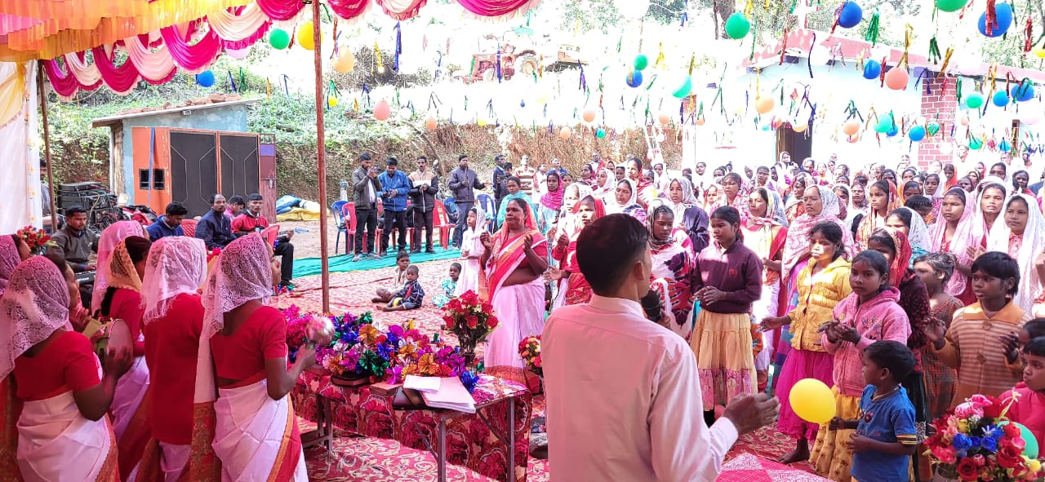
Special Meeting

Slide 16
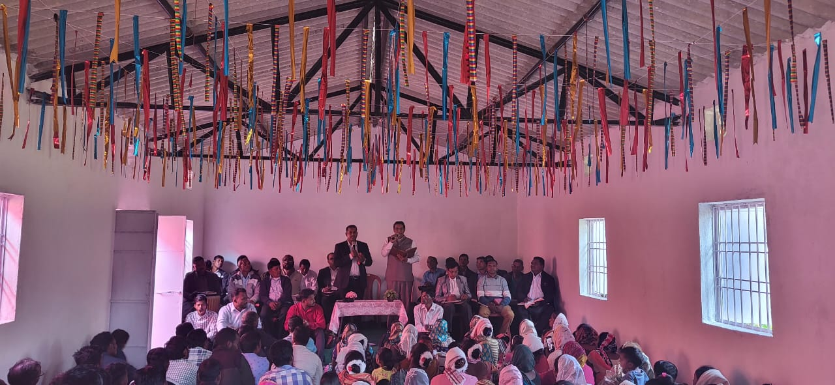
Monthly meeting in Khunti

Slide 17
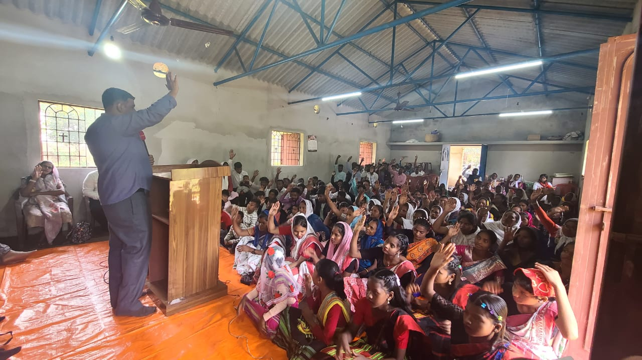
A Church in Jharkhand

Slide 18
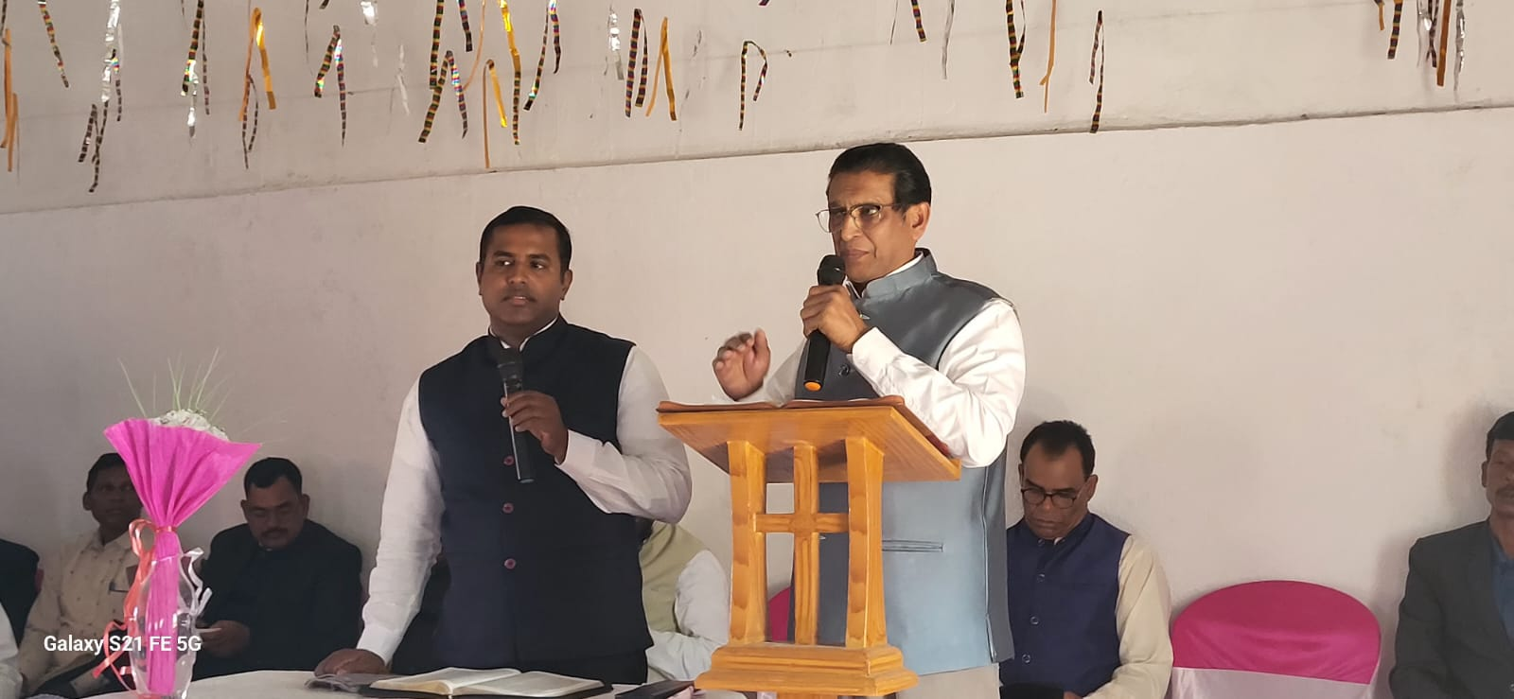
Pastor’s Meeting

Slide 19
U.P

Slide 20
87 Pastors are in Jail.

Slide 21
Thank You

